Slide 1
CUSTOMER CHURN PREDICTION AND RETENTION STRATEGY
Ian Vaati

Slide 2
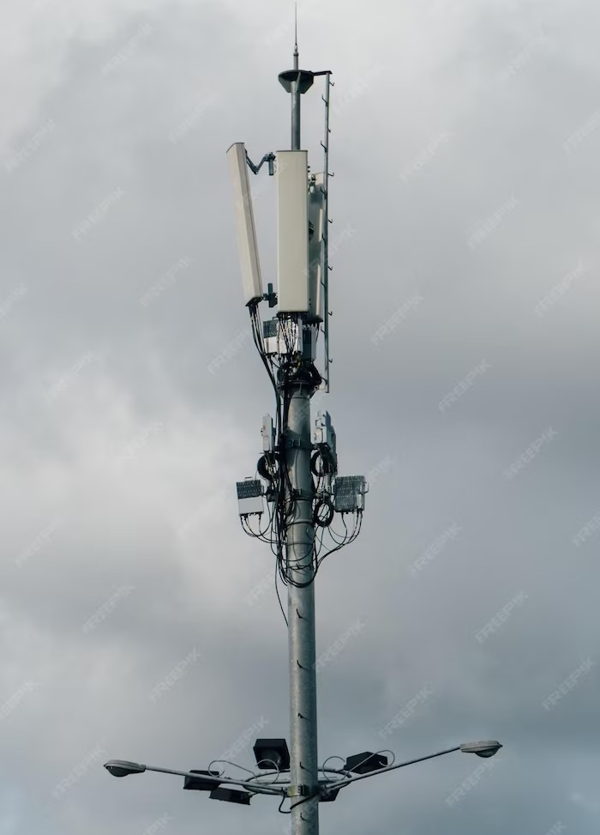
Overview
01.
Introduction
02.
Details
03.
Model Development
04.
Business Recommendations

Slide 3
INTRODUCTION
01
SyriaTel is the largest mobile operator in Syria with over 13 million customers. They provide a complex dataset that can be used for data analysis and predictive modeling to improve customer experiences and help them make strategic decisions.

Slide 4

01
We must develop a predictive model to minimize customer churn and associated ﬁnancial losses. This model will assess customer behavior and characteristics to determine the likelihood of a customer leaving Syriatel. By identifying patterns that precede customer attrition, we can enable SyriaTel to retain valuable customers and reduce revenue erosion proactively.
Problem Statement

Slide 5
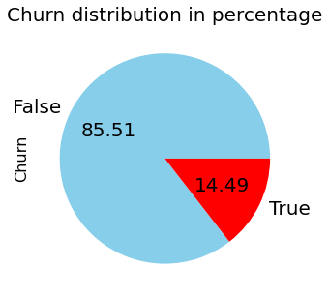
Data Preparation and Exploration
01
Data is from Syriatel, a Syrian telecom company. The target class has an uneven distribution of observations with 85.51% in False and 14.49% in True.

Slide 6
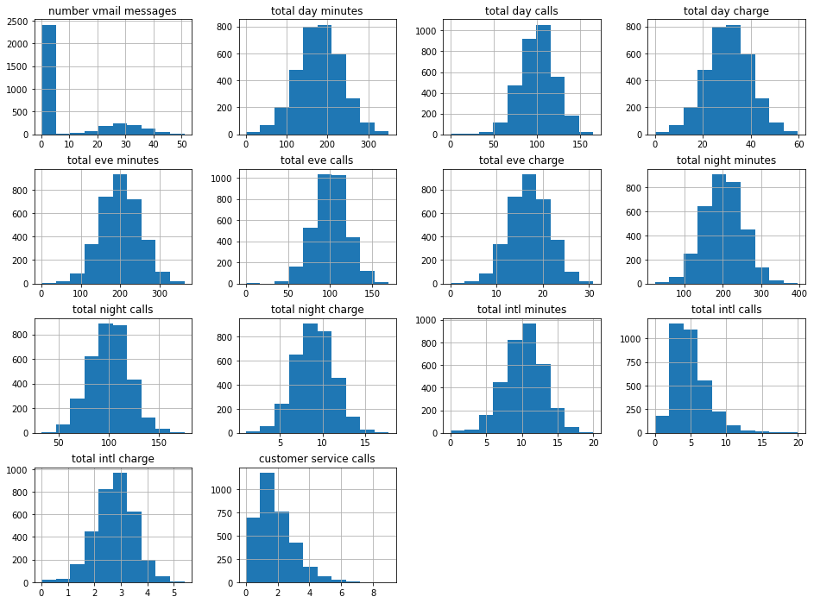
Data Preparation and Exploration
01
The scaling differs across the features, and a few of the features are not normally distributed. The features will therefore have to be scaled and normalized.

Slide 7
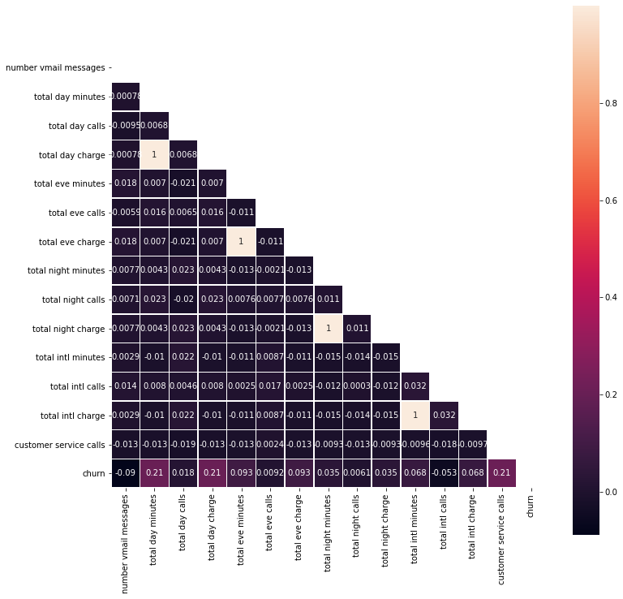
Data Preparation and Exploration
01
The majority of features have a very low correlation, however, some variables are perfectly positively correlated such as total evening charge and total evening minutes. There is weak positive correlation with churn for total day minutes, total day charge and customer service calls, while the rest of the features have a negligible correlation.

Slide 8

MODEL BUILDING AND EVALUATION

Slide 9
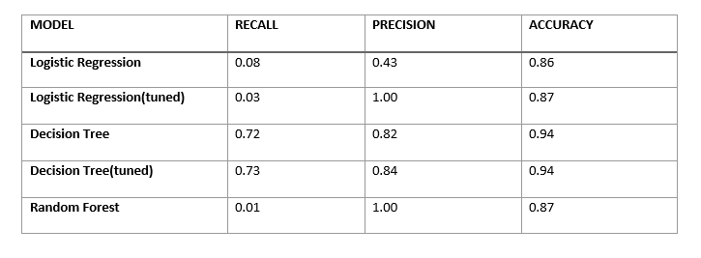
Model Building And Evaluation
03
A logistic Regression model was chosen as it has good performance on binary classification tasks.
Other models were created too. that is Decision tree and Random Forest models.
The image below shows a summary of the models and their performance.
Decision tree with tuned hyperparameters is the model with the best performance. It has the highest precision score. The accuracy and recall scores are above average.

Slide 10

BUSINESS RECOMMENDATIONS

Slide 11

01.
Personalized Marketing Campaign.
Tailor marketing strategies for different customer segments based on insights from the model. Use personalized promotions, discounts, or incentives to retain at-risk customers.
02.
Customer Feedback Loop.
Establish a feedback loop to gather insights from churned customers. Understand their reasons for leaving and use this feedback to improve your services or address common pain points.
03.
Enhance Customer Support.
Improve the quality and responsiveness of customer support. Ensure that customer issues are resolved quickly and satisfactorily. Utilize the model to identify high-risk customers and prioritize their support needs.

Slide 12

04.
Product or service Enhancement.
Continuously assess and enhance the quality of your products or services. Use the model to identify patterns in customer behavior and preferences, which can guide product development and improvements.
05.
Subscription Plan Adjustment.
Consider offering flexible subscription plans or pricing options. Some customers may be churning due to cost concerns or underutilization of certain features. Tailor plans to better match individual customer needs.
06.
Retention Offers.
Develop retention offers for customers at high risk of churning. These could include extended trial periods, loyalty rewards, or exclusive access to new features. Make these offers visible to the identified customers.

Slide 13
07.
Competitor Analysis.
Keep an eye on competitors and what they are offering. Understand why customers may be switching to competitors and adapt your strategies accordingly.
08.
Monitor Customer Behavior.
Continue to monitor customer behavior and adjust your strategies accordingly. The predictive model should be regularly updated with new data to maintain its accuracy.
09.
Data Security and Privacy.
Assure customers of data security and privacy. This is particularly important in industries where data security is a concern. Clearly communicate your commitment to safeguarding customer data.

Slide 14

Conclusion
We have analyzed customer churn prediction and retention strategies and discovered key insights that can shape our business's future. After exploring and processing the data, we developed several models and identified the Decision Tree model as the optimal choice. Our recommendations aim to reduce churn, enhance customer satisfaction, and drive long-term business growth by implementing a proactive customer service strategy, enhancing communication regarding international plans, and monitoring customer engagement during night hours. These findings pave the way for a more data-driven and customer-centric approach, improving customer satisfaction and the bottom line.

Slide 15
Thank you
vaatiian1@gmail.com

